Slide 1

Student Performance Analysis & Prediction
Zhaoqi Fan

Slide 2
Outline
Problem Identification
Data Wrangling
Exploratory Data Analysis
Pre-Processing and Modeling
Conclusion

Slide 3
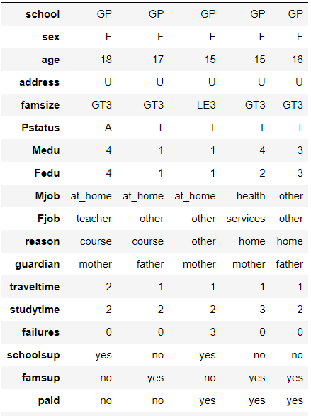
Problem Identification
A survey about student achievement was implemented in the secondary education of two Portuguese schools. The data attributes included student grades, demographic, and social- and school-related features).
Data source:
the dataset was scraped from Kaggle
Constrains:
Some features, e.g., the education of parents, may impact students' performance but not be able to consider in the policy

Slide 4

Problem Identification
What measures can be taken in the secondary school to increase students’ final year grades (G3) by 10% in the next period by introducing new policies?

Slide 5
Data Wrangling
Target variable: G3 is a continuous grade with a range of 0-56. All the rows with G3 of zero are dropped.
Missing data: there are no missing values in the dataset
Duplicates: there are no duplicated rows in the dataset
Data types of features
Data types | Number of features
Nominal object | 17
Ordinal int | 11
Continuous int | 5 (including G3)

Slide 6
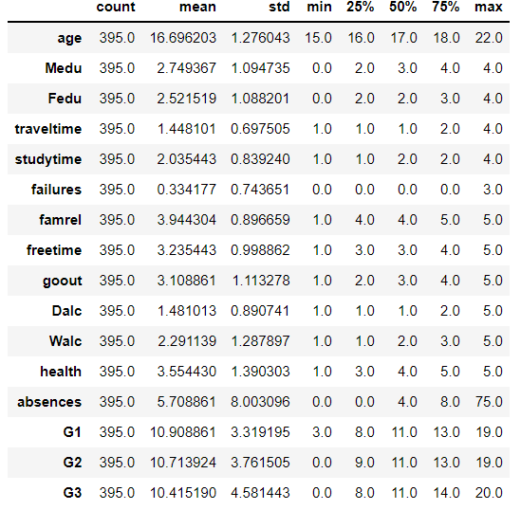
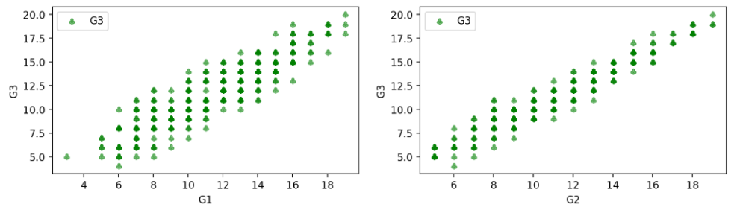
Data Wrangling
Numerical feature statistics

Slide 7
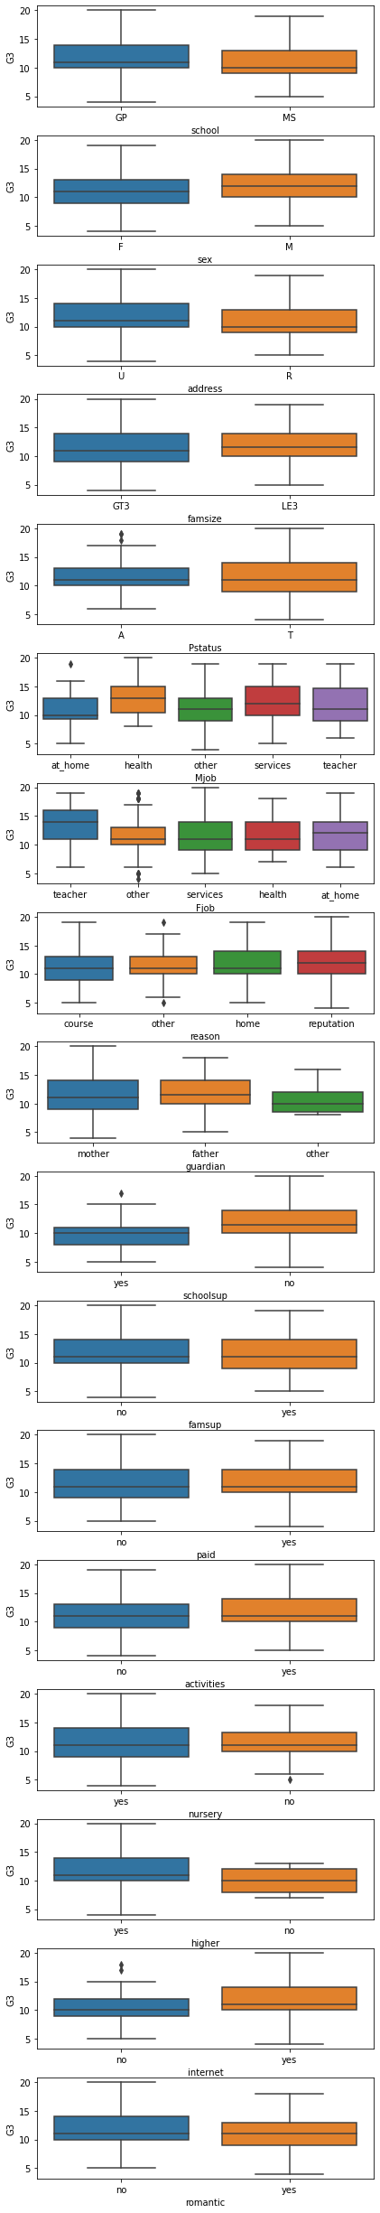
Exploratory Data Analysis
G3 vs categorical features

Slide 8
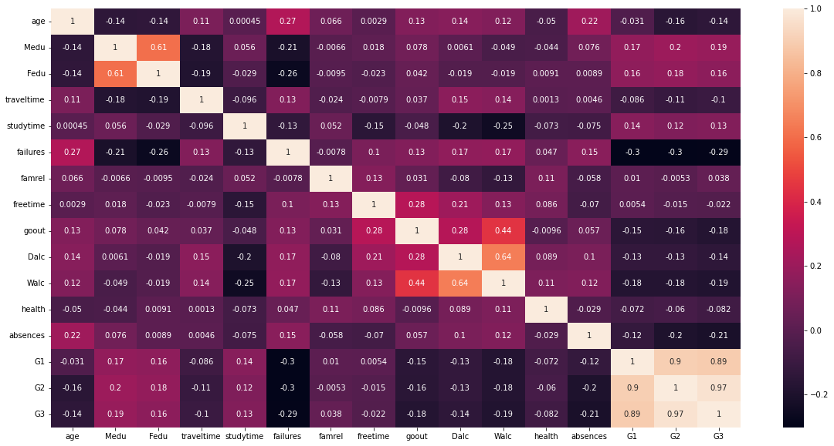
Exploratory Data Analysis
G3 vs numerical features

Slide 9
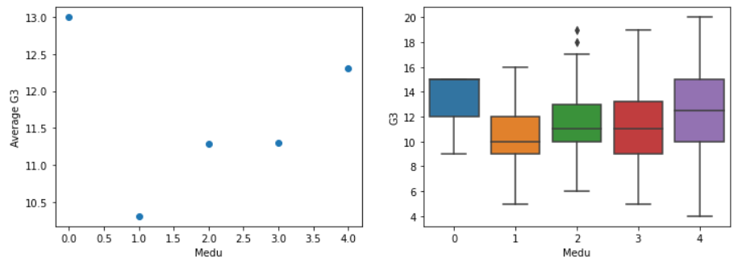
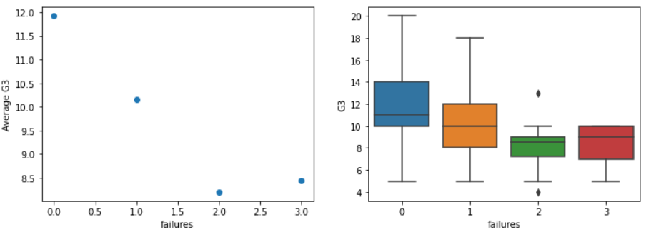
Exploratory Data Analysis
G3 vs numerical features

Slide 10
Pre-Processing and Modeling
pd.get_dummies(): the number of features increased from 33 to 59.
train_test_split(test_size = 0.25)
StandardScaler()
Initial models: Linear and Random Forest regression.
Measures to improve model performance
Dropping the less important features
Applying transformation to some features
Test various test_size

Slide 11
Pre-Processing and Modeling
Model comparison
Model | R2 score |  | Selected model
 | Training data | Test data
Linear Regression | 0.361 | 0.077
Random Forest 1 | 0.884 | 0.139
Random Forest 2 | 0.880 | 0.100
Logistic Regression | 0.618 | 0.042
Ridge Regression | 0.370 | 0.057
Bayesian Ridge Regression | 0.332 | 0.144 | √
Gradient Boosting Regression | 0.796 | 0.033
Support Vector Machine | 0.439 | 0.136
Stochastic Gradient Descent Regression | 0.370 | 0.061
Elastic Net Regression | 0.111 | 0.045
LGBM Regression | 0.834 | 0.097
CatBoost Regression | 0.412 | 0.109

Slide 12
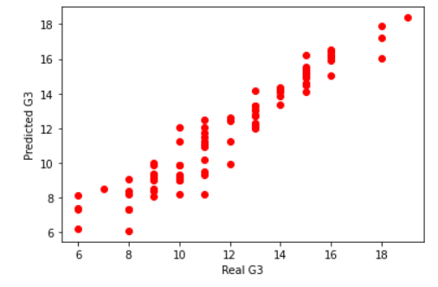
Pre-Processing and Modeling
Refit the Bayesian Ridge Regressor with whole dataset
r2 score is surprisingly reduced to 0.12 from 0.144.
A compromised model: ('G1', 'G2', 'absences', 'failures', and 'G3')
r2 score = 0.942 for training dataset
r2 score = 0.936 for test dataset

Slide 13
Summary and conclusion
The trained model is not reliable to predict G3 under various conditions as all the recommendations will be disputable.
A compromised model only using G1, G2, and a few important features yield a satisfactory predictive model. However, it is not sufficient to deliver solutions for this project.

Slide 14
Recommendations & Future Work
The format of data collection needs to be revised in the following surveys to collect more continuous data for regression, which may help solve the over-fitting problem and find a better predictive model.
As the current features are not strongly related to G3, the experimental design needs to be revised to include more important features and remove negligible features.

Slide 15
Thank you

